Slide 1
Kiln Optimization – Case Study
Technical Development Program SPREAD 2016

Slide 2
Goals of the Study, Key Learnings
Participants can assess “Critical Process Parameters” e.g. temperatures in preheater, hotmeal composition
Participants can calculate and assess “Process Analysis Indicators” e.g. kiln loads and critical velocities
Participants can apply combustion engineering calculations
2

Slide 3
Goals of the Study, Key Learnings
Participants can assess “Critical Process Parameters” e.g. temperatures in preheater, hotmeal composition
Participants can calculate and assess “Process Analysis Indicators” e.g. kiln loads and critical velocities
Participants can apply combustion engineering calculations
Participants are familiar with the optimization procedure:
1. Analysis & assessment of actual situation (where are we now?)
5. Implementation (just do it!)
2. Gap analysis (where should we be?)
4. Find and decide on improvement measures (how can we get there?)
3. Identification of bottlenecks / weak points (why are we not there?)
3

Slide 4
Organization of the Case Study
Case study simulates two production years
For each production year the groups will work during approx. 75 min on the following tasks
Read documents (15’)
Analysis and assessment of situation (30’)
Search for weak points/bottlenecks (15’)
Decide improvement measures (15’)
It is important that the group gets organized at the beginning – distribution of work inside group
The results for each production year will be presented after termination of the group work
4

Slide 5
Schedule
08:30 Introduction year 1 20’
08:50 Work Year 1 60’
09:50 Discussion of results 15’
10:05 Coffee break 25’
10:30 Introduction year 2 10’
10:40 Work year 1 60’
11:40 Discussion of results 15’
Year 1
Year 2
5

Slide 6
Introduction (I)
Each team plays the role of the Process Performance Engineer at the „Dandelion" cement plant operated by Holcim Meadow Ltd.
Plant is equipped with one 4 stage DOPOL preheater kiln and grate cooler commissioned in 1974 (design production 1‘500 t/d cli)
Several upgrades have been carried out since then e.g. new high momentum burner, cooler fixed inlet, new kiln feed system
Recently the kiln system has been upgraded with a precalciner and a tertiary air system (new design capacity 2’500 t/d of clinker)
6

Slide 7
Introduction (II)
However, due to operational problems , the highest achieved production is only 2’350 t/d and the availability is too low
Ordinary coal is the only fuel used, first trials with alternative fuels and petcoke have been started recently
The coal mill has sufficient reserves for higher fineness (even at 100% petcoke), new dynamic separator installed
Raw grinding and cement grinding is not considered in this case study
7

Slide 8

Available Information and Tools
Handouts with introduction and plant equipment data
Heat balance, Lab analysis, KPI and Pareto information
“Reference Guide for Process Performance Engineers”
Pocket calculators (is required)
Templates to fill in solutions
8

Slide 9
Situation Production Year 1
Since kiln upgrade, the production is not satisfactory
Operational problems, frequent kiln stops (see handouts)
The budget production (775‘000 t/a) will not be achieved. Forecast is only 706‘000 tons.
A heat balance was made recently (see handouts)
Coal is still the main fuel, petcoke and AFR is still in trial phase
9

Slide 10
Key Performance Indicators of Year 1
10

Slide 11
Heat Balance Results of Year 1
11

Slide 12
Pareto Analysis Year 1
12

Slide 13
Production Target for Year 2
You as the PPE are in charge of proposing the right measures to achieve next year‘s targets:
Clinker production of 775’000 t/a (same as for year 1)
Kiln availability of 90%
Reduction of specific thermal energy consumption by 5%
13

Slide 14
Task Description for Year 1
Calculate and assess relevant “Process Analysis Indicators” (e.g. kiln loads, critical velocities)
Assess the “Critical Process Parameters” (e.g. pressures, temperatures) and Pareto diagram
Find the bottlenecks/weak points that are limiting clinker production
Propose the relevant improvement measures to reach the targets for the next year
14

Slide 15
Solution – Process Parameters for Year 1
Parameter
Value
Assessment, problems expected ?
Required OEE to reach budget for next year
Required rate index if 90% availability is reached
Burning zone area load of kiln
Kiln volume load
Split of heat input to kiln / precalciner
Thermal burning zone load of kiln
Clinker cooler grate area load
Specific cooling air volume at kiln outlet nose ring
15

Slide 16
Solution – Process Parameters for Year 1
Parameter | Value | Assessment, problems expected ?
Kiln feed / clinker factor
Separation efficiency of top cyclones (referred to kiln feed)
Gas velocity in dip tubes of bottom stage cyclones
Apparent calcination degree of hotmeal
Gas velocity in kiln inlet chamber (narrowest section)
16

Slide 17
Solution – Process Parameters for Year 1
Parameter | Value | Assessment, problems expected ?
Material residence time in kiln
Material filling degree in kiln
Required kiln speed to reach a material residence time of 30 min
Required drive power for a max. installed kiln speed of 4.5 rpm
17

Slide 18
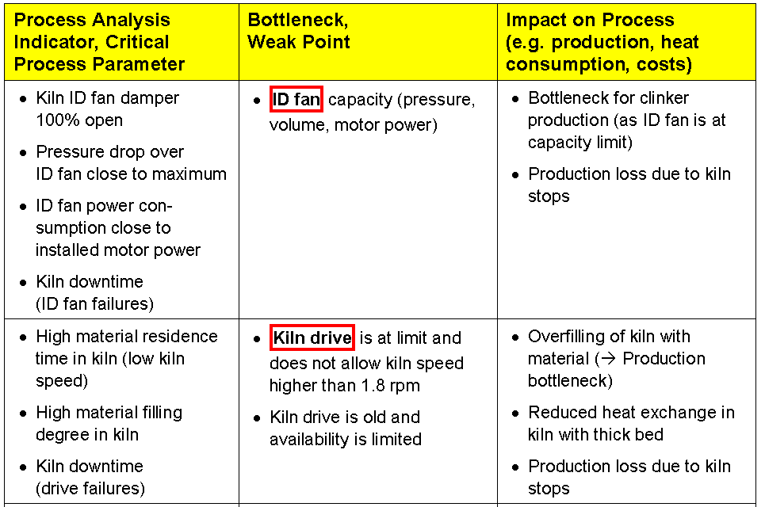
Bottlenecks and Weak Points - Year 1
18

Slide 19
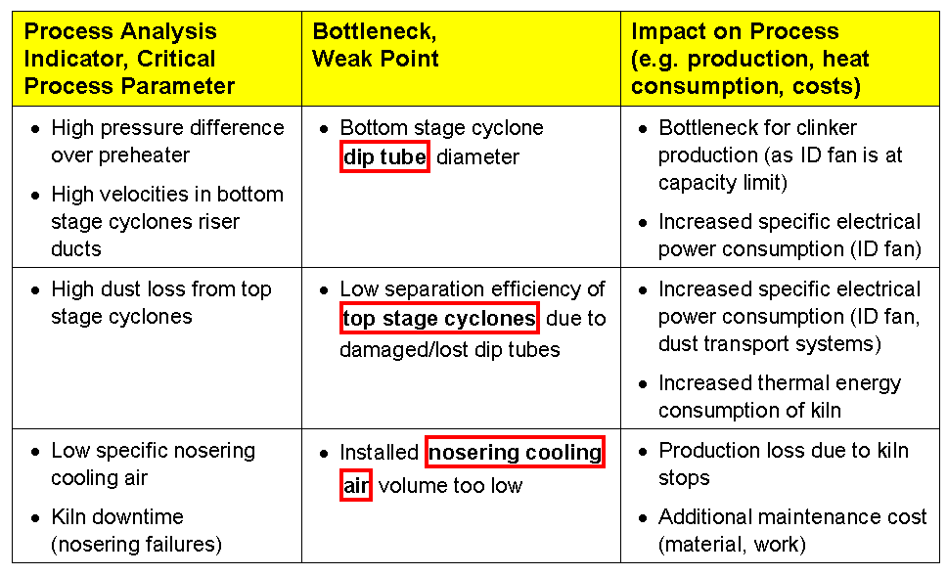
Bottlenecks and Weak Points - Year 1 (cont.)
19

Slide 20
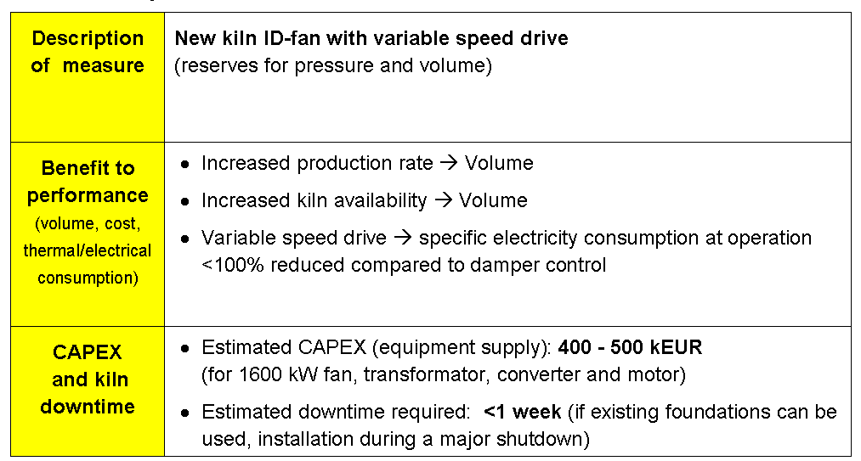
Year 1 - Improvement Measure # 1
20

Slide 21
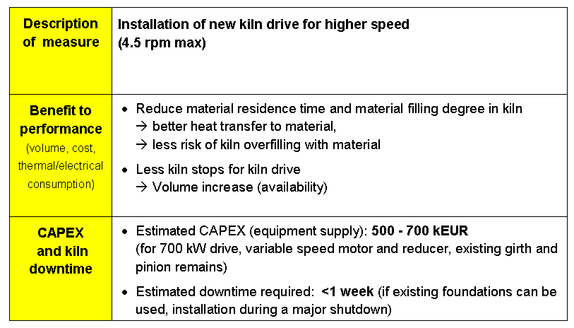
Year 1 - Improvement Measure # 2
21

Slide 22
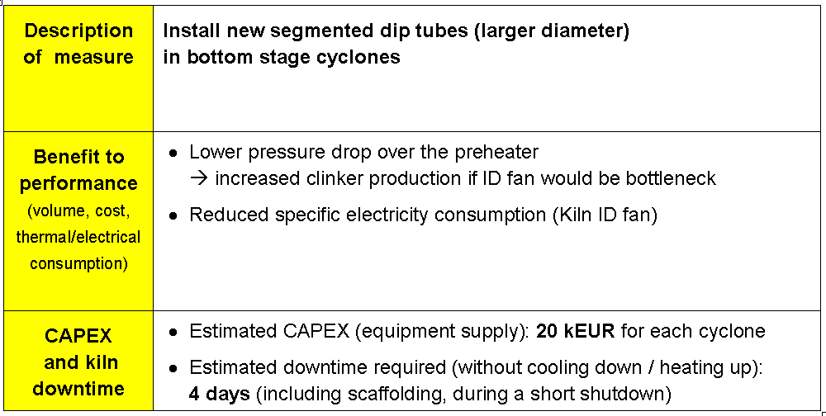
Year 1 - Improvement Measure # 3
22

Slide 23
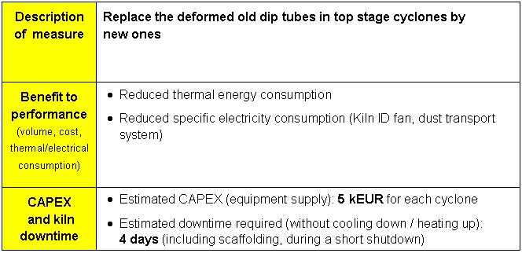
Year 1 - Improvement Measure # 4
23

Slide 24
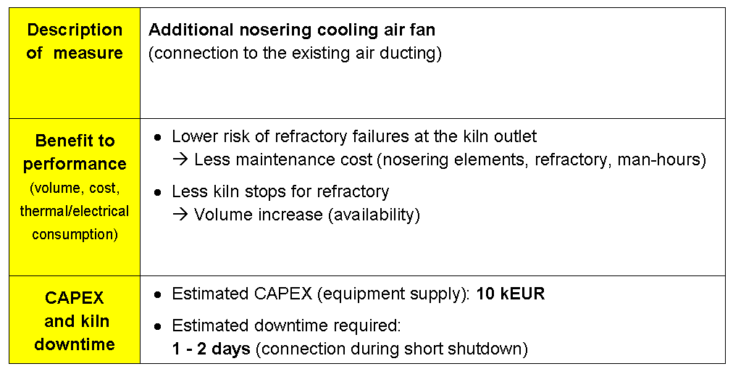
Year 1 - Improvement Measure # 5
24

Slide 25
Situation Production Year 2
All modifications decided in the previous year were implemented during shutdown in January
Realized modifications: new ID fan, new kiln drive, new dip tubes in bottom and top stage, nose ring cooling
Petroleum coke use started last year with first trials, currently around 15-30% substitution could be achieved.
Petcoke initiative identified potential of 75% petcoke substitution
Currently operation problems mainly in the calciner and kiln inlet when feeding more than 20% petcoke
Recently a new heat balance was done (see new handouts)
25

Slide 26
Key Performance Indicators of Year 2
26

Slide 27
Heat Balance Results for Year 2
27

Slide 28
Pareto Analysis Year 2
28

Slide 29
Production Target for Year 3
You as the PPE are in charge of proposing the right measures to achieve next year‘s targets:
Clinker production of 825’000 t/a (6.5% increase)
Kiln availability of 90%
Increase of petcoke / coal mass ratio to 75% / 25%
29

Slide 30
Task Description for Year 2
Calculate and assess relevant “Process Analysis Indicators” (e.g. kiln loads, critical velocities)
Assess the “Critical Process Parameters” (e.g pressures, temperatures) and Pareto diagram
Find the bottlenecks/weak points that are limiting clinker production
Propose the relevant improvement measures to reach the targets for the next year
30

Slide 31
Solution – Process Parameters for Year 2
Parameter | Value | Assessment, problems expected ?
Thermal burning zone load of kiln
Clinker cooler grate area load
Clinker cooler grate width load
Clinker cooling air installed
Clinker cooling air volume during heat balance
Which fan has highest deviation to the installed volume and why?
31

Slide 32
Solution – Process Parameters for Year 2
Parameter | Value | Assessment, problems expected ?
Theoretically achievable clinker temperature (rule of thumb)
Specific secondary air volume
Specific tertiary air volume (approximated)
Air velocity at kiln hood
Air velocity in tertiary air duct
32

Slide 33
Solution – Process Parameters for Year 2
Parameter | Value | Assessment, problems expected ?
Relative false air intake in stage 2 (2nd lowest cyclone)
Required fineness of coal / petcoke mix (%R 90 μm)
Gas residence time in precalciner
Sulfur volatility in kiln
33

Slide 34
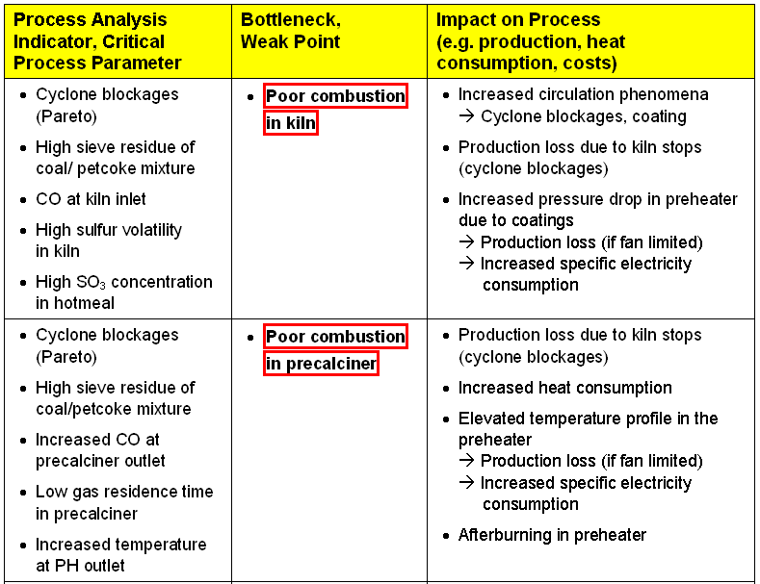
Bottlenecks and Weak Points - Year 2
34

Slide 35
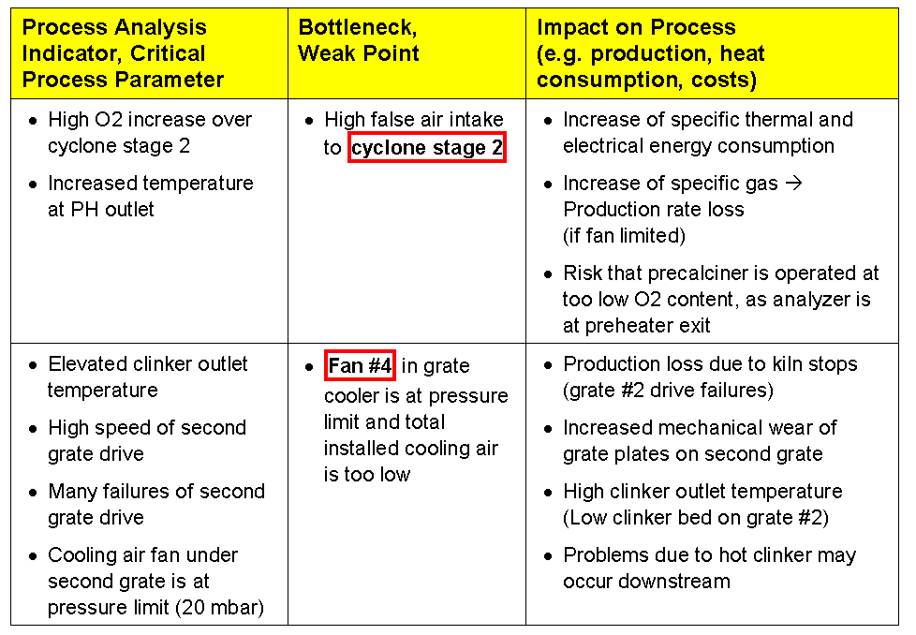
Bottlenecks and Weak Points - Year 2 (cont.)
35

Slide 36
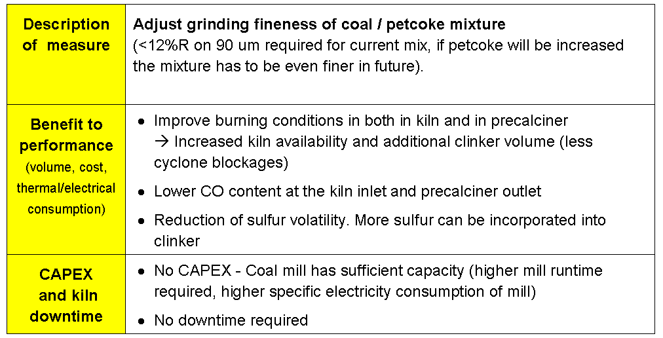
Year 2 - Improvement Measure # 1
36

Slide 37
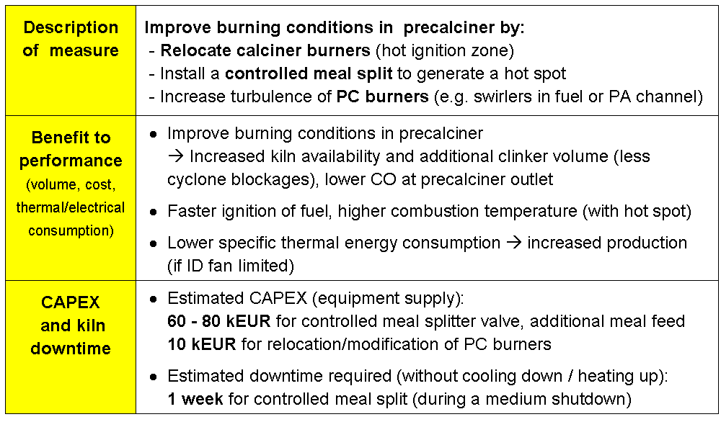
Year 2 - Improvement Measure # 2
37

Slide 38
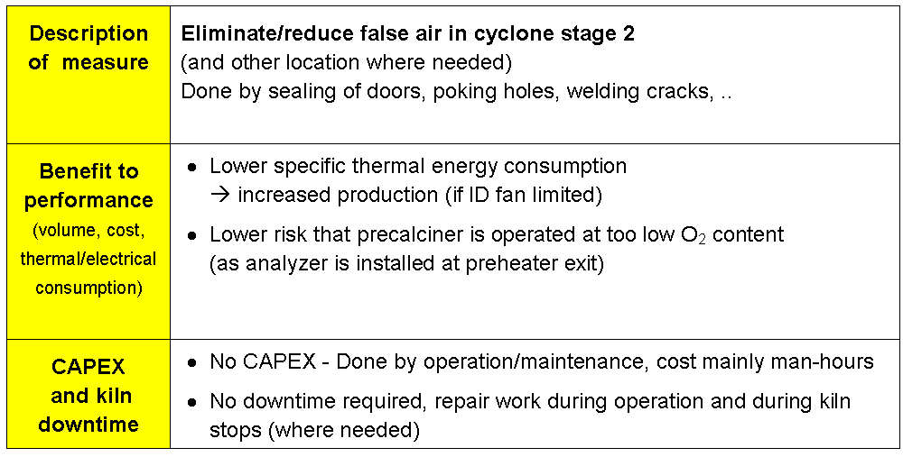
Year 2 - Improvement Measure # 3
38

Slide 39
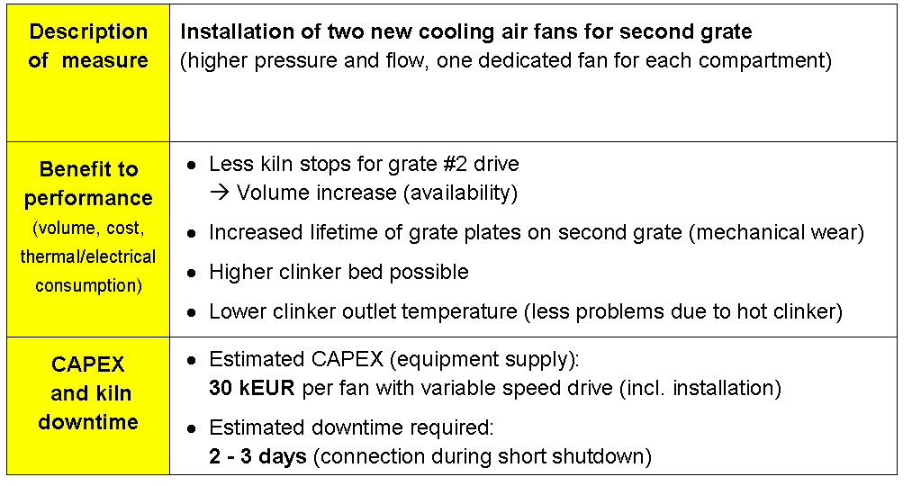
Year 2 - Improvement Measure # 4
39

